Slide 1



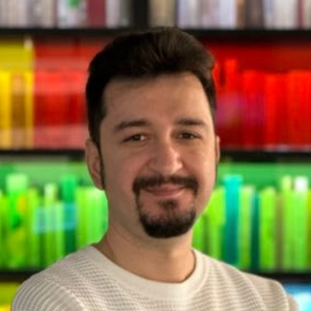
Implementing Domain-Driven Design as a pragmatic developer
Download the Presentation
Halil İbrahim Kalkan
Co-founder, Volosoft

Slide 2

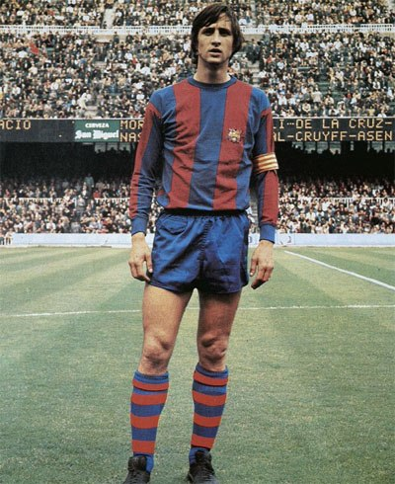
Writing «simple» Code
«Playing football is very simple, but playing simple football is the hardest thing there is!»
Johan Cruyff
«Writing code is very simple, but writing simple code is the hardest thing there is!»
Halil İbrahim Kalkan

Slide 3
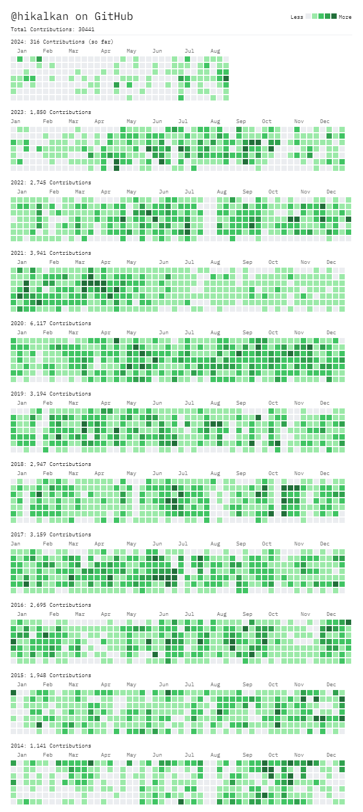







About Me: Halil İbrahim Kalkan
1997, Started programming (at 13 with Pascal)
2007, Computer Engineering
2007 - 2015: Software developer, software architect, team leader
2013 - ∞: Lead developer of the open source ABP Framework
2016 - ∞: Co-founder, software architect
Multi-threading, distributed/microservice systems, OOP, DDD, software architectures.. etc.
Active coder, open-source contributor
30,000+ total contributions on GitHub

Slide 4
TITLE
.

Slide 5
TITLE
.

Slide 6
TITLE
.

Slide 7
TITLE
.

Slide 8
TITLE
.

Slide 9
TITLE
.

Slide 10
TITLE
.

Slide 11
TITLE
.

Slide 12
TITLE
.

Slide 13
TITLE
.

Slide 14
TITLE
.

Slide 15
TITLE
.

Slide 16
TITLE
.

Slide 17
TITLE
.

Slide 18
TITLE
.

Slide 19
TITLE
.

Slide 20
TITLE
.

Slide 21
TITLE
.

Slide 22
TITLE
.

Slide 23
TITLE
.

Slide 24
TITLE
.

Slide 25
TITLE
.

Slide 26
TITLE
.

Slide 27
TITLE
.

Slide 28
TITLE
.

Slide 29
TITLE
.

Slide 30
TITLE
.

Slide 31
TITLE
.

Slide 32
TITLE
.

Slide 33
TITLE
.

Slide 34
TITLE
.

Slide 35
TITLE
.

Slide 36
TITLE
.

Slide 37
TITLE
.

Slide 38
TITLE
.

Slide 39
TITLE
.

Slide 40
TITLE
.

Slide 41
TITLE
.

Slide 42
TITLE
.

Slide 43
TITLE
.

Slide 44
TITLE
.

Slide 45
TITLE
.

Slide 46

THANKS FOR
WATCHING
Download the Presentation

